Slide 1
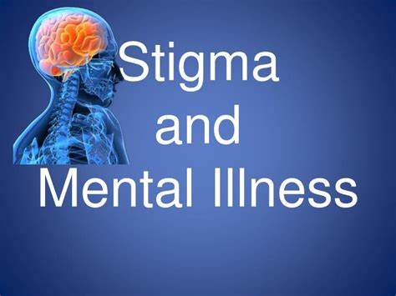
Presenters:
Dr. Martin F. Hill, LMHC
Worshipful Master
Meridian Lodge #33
Dr. B. Randal Horton, HSPP
Central Lodge #1
Prince Hall Grand Lodge
Health Services Committee
Jurisdiction of Indiana

Slide 2


Stigma and Beliefs on Mental Health Public stigma involves the negative or discriminatory attitudes that others have about mental illness. Self-stigma refers to the negative attitudes, including internalized shame, that people with mental illness have about their own condition. Institutional stigma, is more systemic, involving policies of government and private organizations that intentionally or unintentionally limit opportunities for people with mental illness. Stigma not only directly affects individuals with mental illness but also the loved ones who support them, often including their family members. Stigma and judgment prevent people from seeking treatment for their mental illnesses

Slide 3


Slide 4

Myths about Mental Health
Myth 1: Mental health issues are uncommon.
As we all know, mental illnesses are not abnormal and rare brain mutations. According to the World Health Organization, it was estimated that 1 in 4 people will personally experience mental health problems in their lifetime, and this number has surely risen in recent years.
Myth 2: People with mental illnesses are violent and unpredictable.
People with mental illnesses are often labelled as being “bizarre or crazy” and it is widely believed that they don't have control over their bodies, giving in to violent impulses and urges. It’s been proven that only 3-5% of acts of violence correlate to mental illnesses. Those living with mental illnesses are 10 times more likely to be victims of violence due to discrimination; those with mental health issues are often alienated.
Myth 3: People with mental illnesses should just “get over it”.
Mental health issues are not simply caused by minor problems in one’s life, other contributing factors like brain chemistry and genetics also play important parts. These are not in one’s control nor are they simple problems that one can just solve or “get over”.
Myth 4: Those with severe mental illnesses aren’t able to work.
It is falsely believed that because of their mental illnesses, people with them would be under too much stress to hold down a job. However, this is completely wrong as people who appear “normal” may be high-functioning but still struggle with mental illnesses. In 2014, a study found that in the US, 68.8% of people with mild mental illnesses are employed, which shows that mental problems do not negatively affect productivity in the workspace.

Slide 5

Each year, millions of Americans face the reality of living with a mental health condition. Mental illness affects everyone directly or indirectly through family, friends or coworkers.

Slide 6
Mental Health Stats in America by Mental Health America, Inc
In 2019, just prior to the COVID-19 pandemic, 19.86% of adults experienced a mental illness, equivalent to nearly 50 million Americans.
1 in 5 U.S. adults experience mental illness each year
1 in 6 U.S. youth aged 6-17 experience a mental health disorder each year
Over half of adults with a mental illness do not receive treatment, totaling over 27 million adults in the U.S. who are going untreated.
The percentage of adults with a mental illness who report unmet need for treatment has increased every year since 2011. In 2019, 24.7% of adults with a mental illness report an unmet need for treatment.
Rates of substance use are increasing for adults, even prior to the COVID-19 pandemic. 7.74% of U.S. adults had a substance use disorder in the past year. Substance use increased 0.07% for adults over last year’s report.
To expedite services and give a specific number for behavioral health emergencies such as Suicidal Ideation a new emergency number has been implemented: 988 July 2022 starts the official use of 988 in Indiana. Until then, continue to utilize, 1-800-273-8255(TALK)

Slide 7
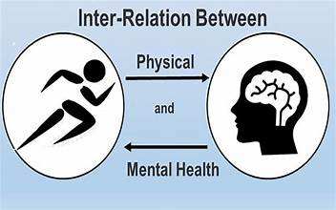
What are physical symptoms of mental health diseases?
Under weight or Obesity (problematic dietary behaviors)
heart, liver, lung, autoimmune disease, and chronic headaches (alcohol and tobacco use as well as illicit substance use).

Slide 8
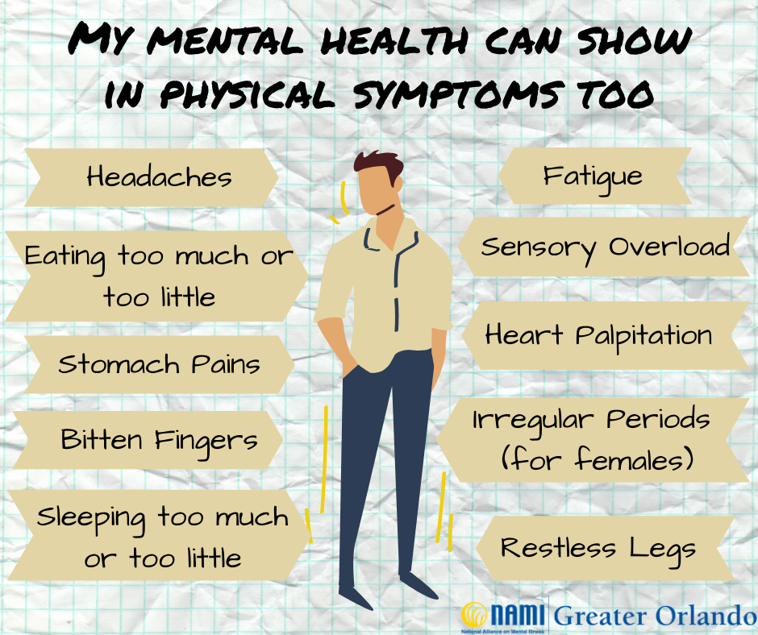

Slide 9

How do I help a friend or family member pursue mental health services?
The three basic action principles of Psychological First Aide (PFA) are Look, Listen and Link.
These actions will help you approach the individual, begin to understand their needs and link them to support and information.

Slide 10

Psychological First Aide
LOOK
» Check for safety…home environment/medication compliance/ food-water, evidence of self-injury; hygiene changes
» Check for people with serious distress reactions (crying spells, dark circle under eyes, weight loss or gain; isolating; impulsive behaviors—drugs, sex, money spending.
LISTEN
» Approach people who may need support.
» Ask about people’s needs and concerns** Asking about suicidal ideations ( thoughts/ Intent) is not going to cause someone to think about it or attempt it
» Listen to people and help them to feel calm.
LINK
» Help people address basic needs and access services.
» Give information: 988 Mental Health Emergency Number; domestic abuse; child protective services/adult protective services; 911; hospital or urgent care
» Connect people with other loved ones and social support

Slide 11

There is hope. People with mental disorders can be helped by treatment. Treatment can include:
Medication – The doctor may recommend one or more medicines to find what works best.
Counseling – Often, psychotherapy or other forms of counseling are used in combination with medication.
Peer Support – The advice and support of others who have bipolar disorder can aid recovery.
Complementary Care – Some people benefit from exercise, stress reduction classes and other activities to complement their treatment and help them manage their illness.

Slide 12


Ten Things you can do
For your Mental Health:
Value yourself
Take care of your body
Surround yourself with good people
Remember self-care
Learn how to deal with stress
Quiet your mind
Set realistic goals
Break up the monotony
Avoid alcohol and other drugs
Get help when you need it

Slide 13

Discussion

Slide 14

Indiana Association of Black Psychologists
P.O. Box 36231
Indianapolis, IN 46236-9998
Email: indianaabpsi@gmail.com
Website: psychologyinblack.org
Central Indiana Association of Black Social Workers
PO Box 20149
Indianapolis, IN 46220
Email: cic.absw@gmail.com
Website: http://cicabsw.weebly.com/
National Medical Society (List of Black Physicians Indianapolis chapter: Aesculapian Medical Society)
222 E. 63rd Street Indianapolis, IN 46220 T: 317-697-7157 F: 317-278-2691
jespada@iu.edu
Website: https://www.aesculapianmedicalsociety.org/

Slide 15
Emergency Phone Numbers
911 - Emergency
988 - National Suicide Prevention Lifeline
National Domestic Violence Hotline: +1 (800) 799-7233
Family Violence Helpline: +1 (800) 996-6228
Adult Abuse Reporting/Crisis Intervention: +1 (800) 510-2020
Self-Harm Hotline: +1 (800) 336-8288
American Association of Poison Control Centers: +1 (800) 222-1222
Alcoholism & Drug Dependency Hope Line: +1 (800) 622-2255
National Crisis Line, Anorexia and Bulimia: +1 (800) 233-4357
The Child help National Child Abuse Hotline: +1 (800) 422-4453
The Trans Lifeline: +1 (877) 565-8860

Slide 16




