Slide 1
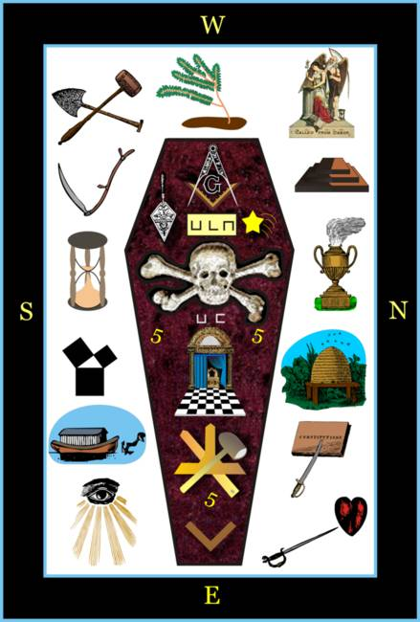
Masonic Burial Rites and Services
Compiled By
Bro. Ahmad R. Perry, P.M.
Grand Lecturer
Notes:
Introduction

Slide 2
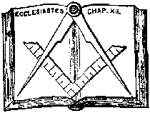
Worshipful Master’s duties when a death occurs?
All information shall come from the W.M.
Contact family upon notification of death
(Meet in person, if applicable)
Contact the Lodge and Masonic bodies
(Presiding Officer)
Make arrangements to meet with the family at their convenience with other Masonic heads and all dressed as Master Masons.

Slide 3
What do you talk about?
Introduction
Expression of personal sympathy
Speak naturally about deceased
(relationships,memories,activites)
Mention Masonic service
(families right to request or deny)
Keep in contact with the family for any updates
Notes:
***if not possible, bring a brother who is personally acquainted. ****Allow family to choose what rites to have, NO Pressure

Slide 4
What to tell the family about the Masonic Service?
In memory of deceased brother
(designed for family, friends, brethren)
Aid the grief of the loved ones
Work in Cooperation
(family, pastor, funeral director)
Length of service
(Lodge, Appended/ Adopted Bodies)
Death Certificate
(Grand Secretary)

Slide 5
What should the Worshipful Master know about the Masonic Services?
Inform the Craft of services
(Lodge and Appended/Adopted Bodies)
Time and place
District Deputy Grand Master
Have the proper burial regalia
Start rehearsing for Rites
Notes:
* WM should communicate with the heads of houses **WM and Marshal to survey the place of services *Masters be ye ever ready! No one knows the time or place of death, you should prepare for the Rites BEFORE you become Master of your Lodge.

Slide 6
Preparation for the Rites
Deceased brother must be a M.M.
Be in good standings
Must be affiliated
Must be an honorable death
Request of Rites must be known(put it in writing, keep in a safe place, and notify your family)
Pall bearers
Notes:
******Should be Mason with concurrence of the family, if the brother was a member of Chapter, Commandery, or Consistory an portion should be pall bearers, ALL dressed as Master Masons

Slide 7
Proper Dress for the Rites
LODGE
Master hat /Black top hat
Black suit, tie, shoes, socks
White shirt, apron/gloves(plain)
Black crepe (left arm above elbow)
Evergreen(left breast pocket)
NO pins or emblems
ADOPTED/APPENDED BODIES
Collars, jewel, and regalia

Slide 8
Proper Regalia Items
Masters Gavel
Jewel of officers ,P.M., and G.L. officers
Wardens Columns
Deacons/Stewards Staff
Tyler's Sword
SVL
Book of Constitutions
Marshals Baton
ALL in black crepe with white ribbon
Apron for deceased brother
Sprig of Acacia

Slide 9
Rules during the Rites
The Master of the Lodge is in strict charge of the Rites
The Rites are designed and typically performed at the grave site, if not
After the clergyman shall have performed all religious exercises of the church, the Masonic service shall begin or prior to the beginning of the service; it is the families choice.
The Lodge in procession is under the strict discipline of the Lodge room.
If united by civil societies/military, the body of the deceased must be in charge of the Lodge having Jurisdiction. Services must be conducted as if none but masons were present.
The brethren will assemble around the casket, if at church or grave site
In all instances, inside or outside, excessive talking must be held to an absolute minimum and at low voice. The dignity of the occasion and the fraternity requires the actions of a gentleman. ALL Masons should admonish those who violate this code of conduct.
Notes:
*Depending on time and order of funeral service. **Master is in charge, no brother can enter or leave without the permission of the WM conveyed through the Marshal.

Slide 10
Order of the Rites and Procession
Heroines of the Templar Crusades, the Guild
Ladies of the Circle of Perfection, LOCOP
Heroines of Jericho, HOJ
Order of the Eastern Star, OES
Ancient Egyptian Arabic Order of the Noble and Mystic Shrine, AEAONMS
Ancient and Accepted Scottish Rite, AASR
Knight Templar, KT
Royal and Select Masters, R&SM
Holy Royal Arch Mason, HRAM
Grand Lodge(if applicable)
Lodge F&AM
Notes:
Whether you are performing the rites or resolution, Sisters first then the brothers

Slide 11
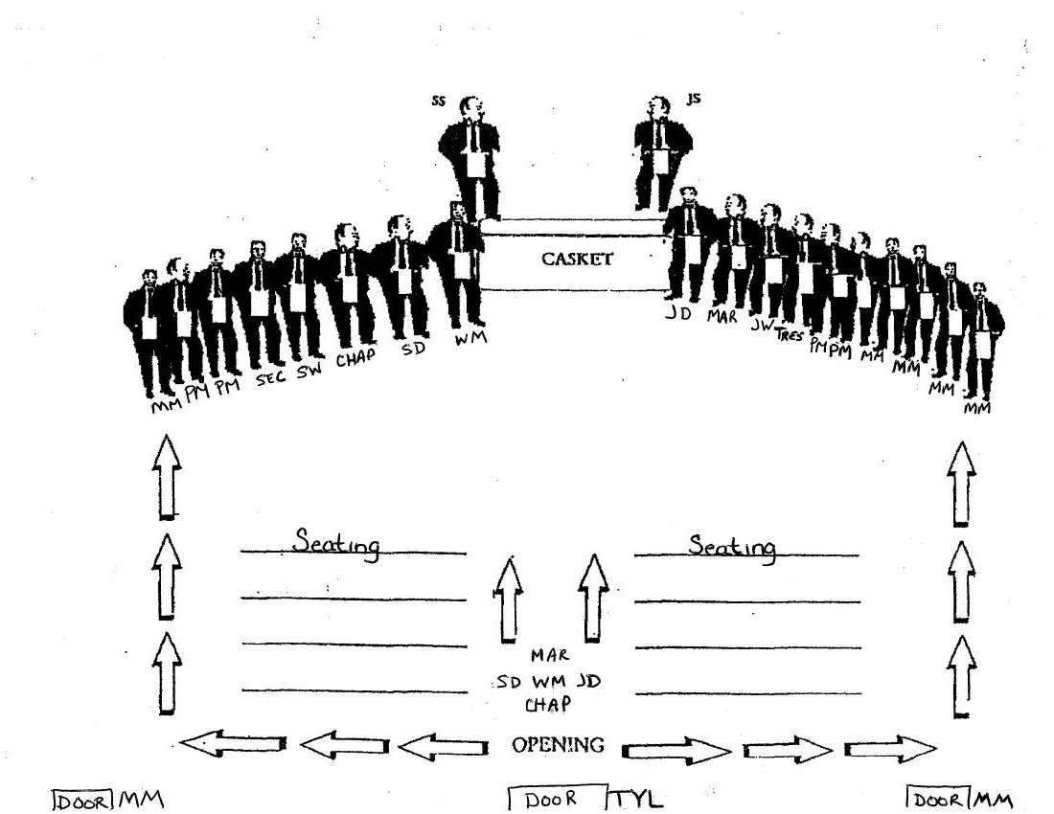
The Procession
*Sr/Jr Stewards,Tyler are to be in position before the procession begins.
*WM can move to the center of casket.
*Marshal can be in line or middle isle.
Notes:
*Layout is subject to change, Order of service: Prayer, Exhortation, deposit of lambskin. After prayer chaplain will say Amen and the Craft So mote it be.

Slide 12
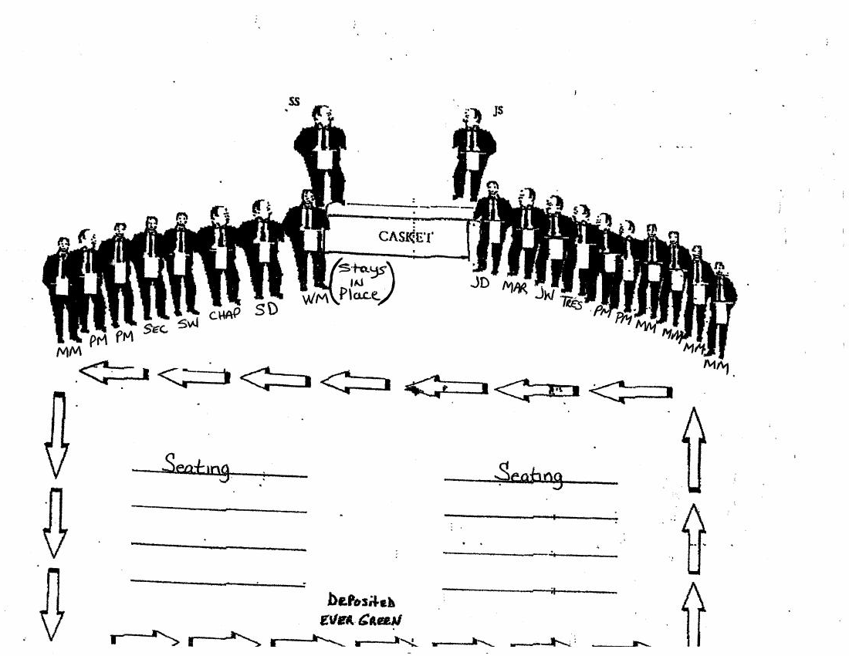
Deposit of Evergreen
*Travel from foot to head
Notes:
*Subject to change of deposit of evergreen
*If the facility will not allow the Craft to deposit the evergreen, the deposit will only be made by the WM

Slide 13

Grand Honors
Notes:
The Craft is to take their mark from the WM

Slide 14
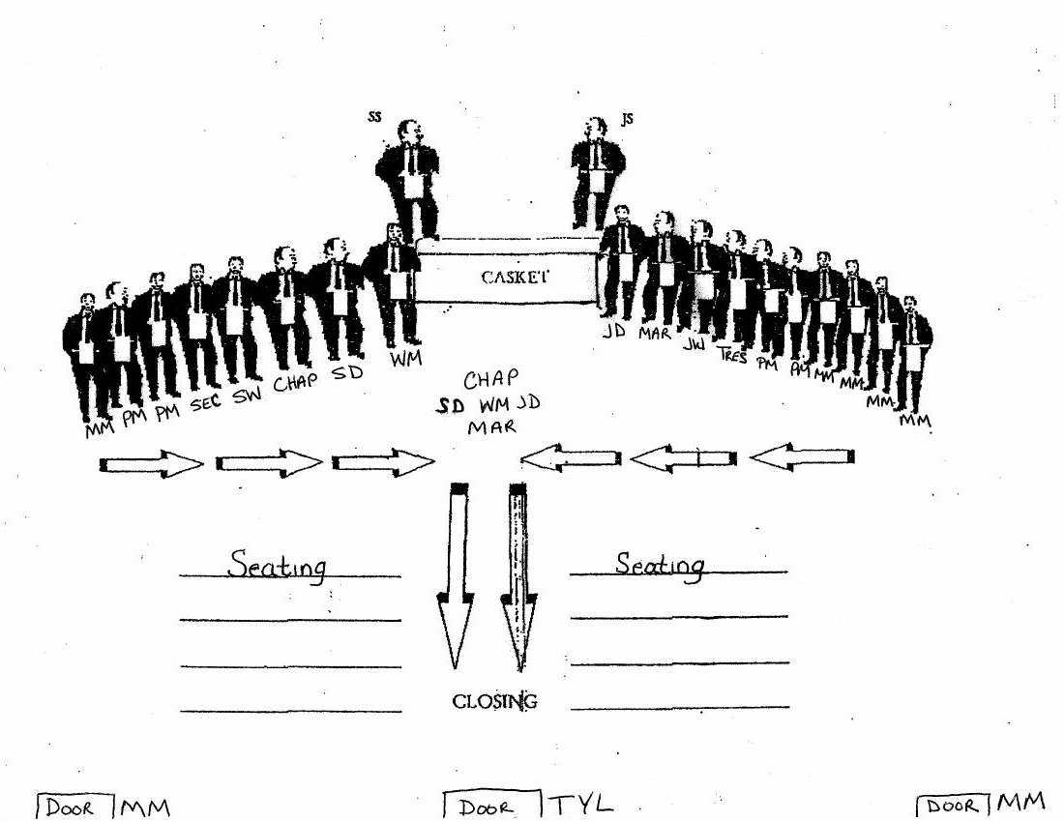
The Recession
*Sr/Jr Stewards,Tyler remain in place
*Craft leaves first, then Mar, WM, SD ,JD, Chap.
Notes:
*Subject to change. Once the Rites are given and the last prayer prayed, the Master will give the benediction: The will of God is done. So mote it be. From dust we came and unto we shall return. So mote it be. May we all be recompensed at the resurrection of the just. Amen. Then the Master orders the Marshal to take charge.

Slide 15
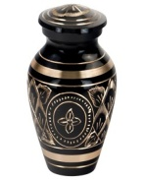

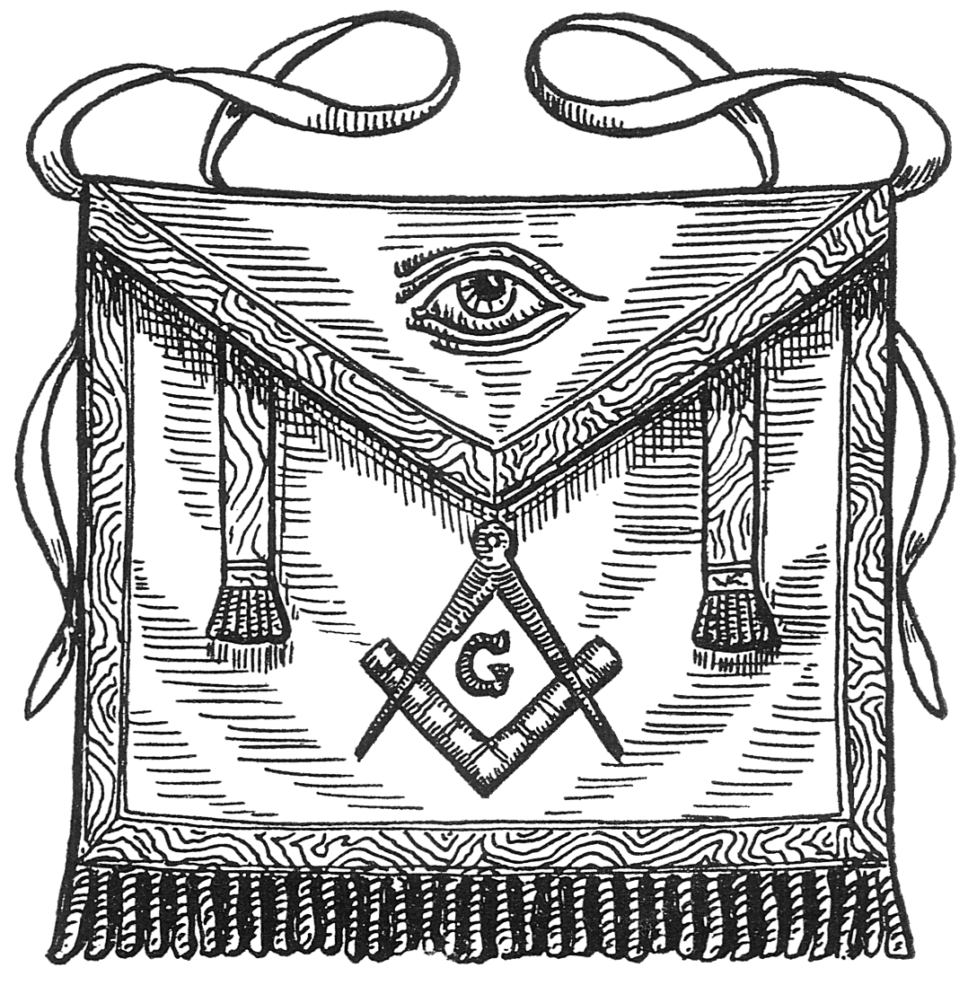
Cremation Service and Formation
WM
SW
JW
Urn
Chaplain
Bible
Bearer
Table
Floral
arrangement
Apron
Notes:
Services can be found in MWPHGLIN Constitution and By-Laws, 2018

Slide 16
Additional Information
Masters, study the rite. This is your duty. | All communication comes from the WM.
If you are not able to find a PM or competent brother, prepare a resolution. | Work in unison with the family, church and funeral home.
Resolutions are to be given to wife, widow, children, or closest relative. | Prepare regalia and/or resolution upon notice of death.
Update your information with the Lodge, get your affairs in order and put it in writing,ie mortuary relief, life insurance, will(living). | WM and Marshal should survey place of services asap.
Ensure your pastor/church will allow Masonic Rites. | Arrive early to church/funeral home. EARLY IS ON TIME, ON TIME IS LATE
If there is a conflict in the family, offer your services, but DO NOT make decisions. If you have met the Pastor; thank that person for ALLOWING us to perform the Rites | Do not be afraid to ask for help, a brother has traveled same road your are on. If possible be there for the family during and after the service

Slide 17
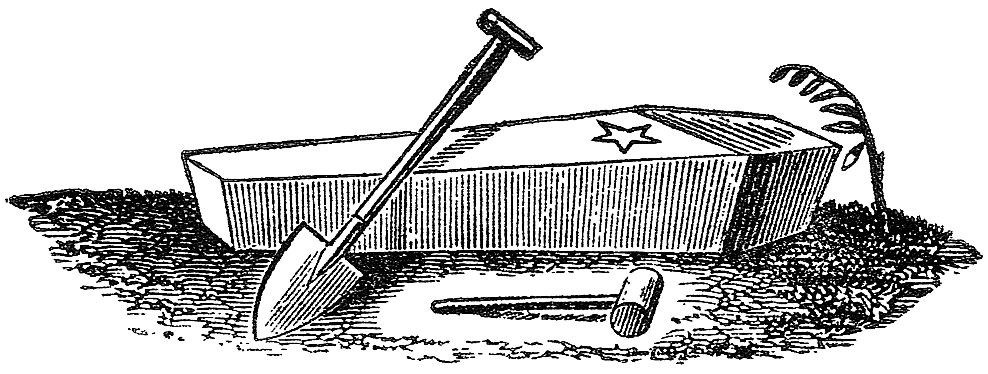
Closing
There is no service within our fraternity more important or deserved to show our brotherly love more deeply than that of following our brothers body to the grave for interment with the appropriate Masonic rites. The eyes of the world are upon us daily. Show then a Fraternity dedicated to upholding the honor, glory, and reputation we so long enjoyed.
Respectfully and Fraternally,
Douglas C. Landers, Sr.
MWPGM

