Slide 1


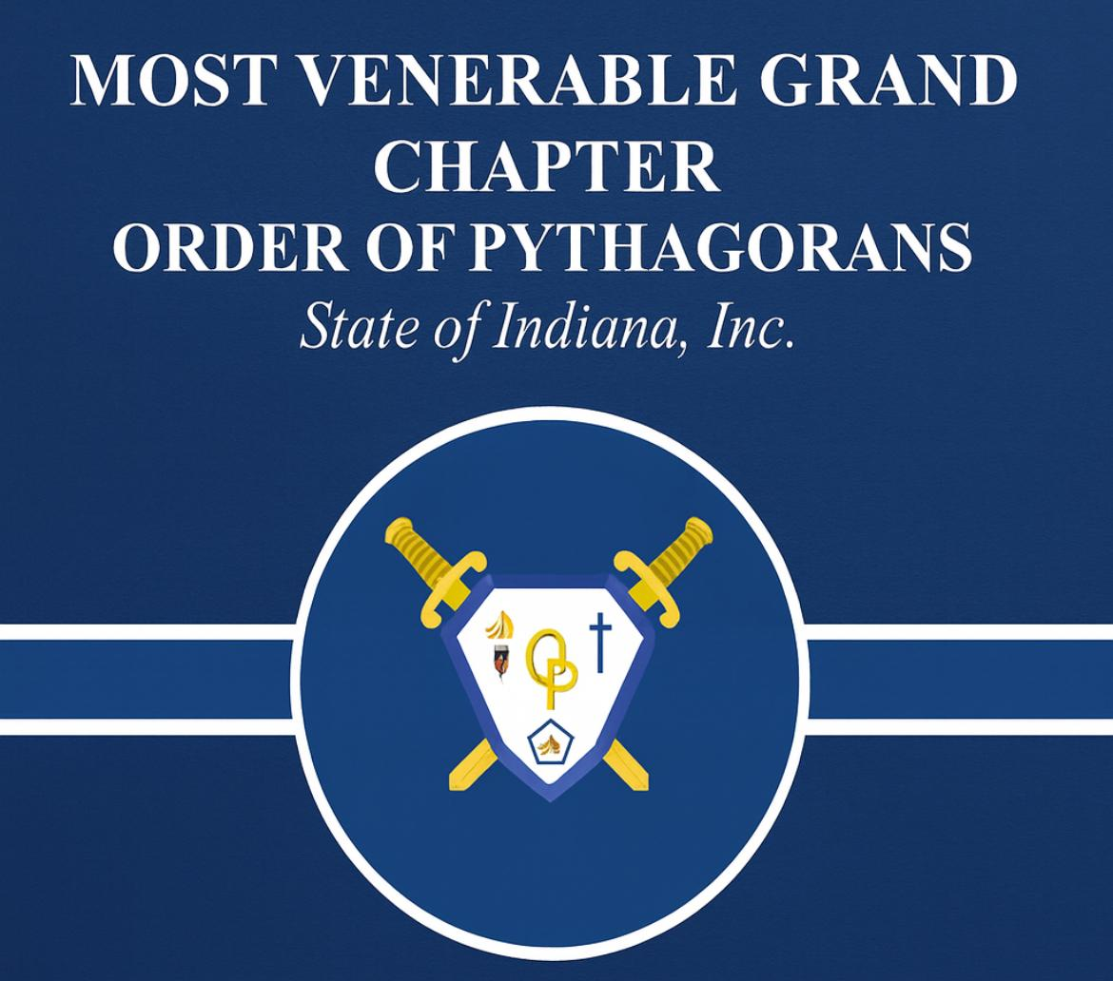
BRO. DAVID B. KENNEY
CENTRAL LODGE #1
“BUILDING THE NEXT GENERATION OF LEADERS!”

Slide 2
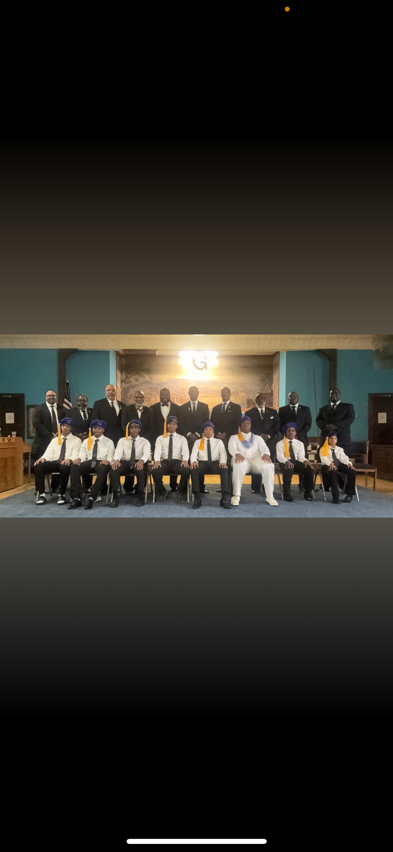

Slide 3
The Order of Pythagorans is the official youth organization for young men ages 10–18 within Prince Hall Masonry.
Rooted in leadership, moral development, and community service, this program equips young men with the tools to become future leaders — both within our lodges and in their communities.
Why Now:
1. Membership in many lodges is declining.
2. We must intentionally build a leadership pipeline.
3. Today’s youth need guidance, structure, and examples of excellence.
4. The Order of Pythagorans is a proven way to preserve our legacy while investing in the future.
PURPOSE AND OVERVIEW

Slide 4
To successfully launch and sustain this program statewide, we are asking for:
Active Lodge Participation: Each district and lodge to support youth engagement.
Mentorship: Brothers willing to step up as role models and advisors.
Youth Recruitment: Sons, nephews, family members, and boys from our communities.
Space & Visibility: Lodge facilities and public platforms to hold meetings, events, and ceremonies.
OUR WANTS!

Slide 5
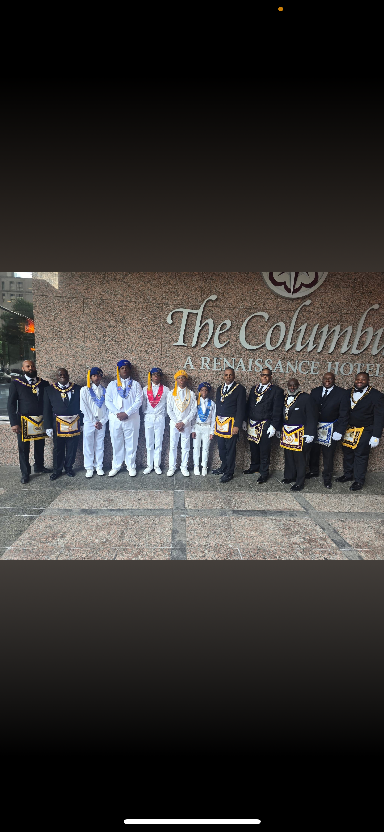

Slide 6
To make this program thrive, certain structural elements must be in place:
Formal Reactivation & Approval by the Grand Lodge.
Administrative Framework including bylaws, calendars, officer structures, and reporting systems.
Advisor Training to ensure all adult leaders are equipped to lead effectively and responsibly.
Financial Support to cover uniforms, travel, supplies, educational materials, and events.
OUR NEEDS ARE YOU!!!!!

Slide 7
Participation in the Order of Pythagorans comes with shared responsibility. We expect:
Consistent Engagement from participating lodges and districts (monthly activities & communication).
Attendance at Statewide Events to foster unity and shared identity.
Adherence to Masonic Values & Youth Protection Guidelines at all times.
Collaboration & Communication between local Chapters and Grand Chapter leadership.
EXPECTATIONS

Slide 8
Strengthened Community Image through visible youth service.
Pipeline for Future Masons — Pythagorans become tomorrow’s Brothers.
Leadership Opportunities for Brothers who mentor and guide youth.
Relevance to Younger Generations, keeping the Lodge connected to the evolving community.
Increased Lodge Engagement through joint programs, events, and outreach.
BENEFITS TO THE LODGE

Slide 9
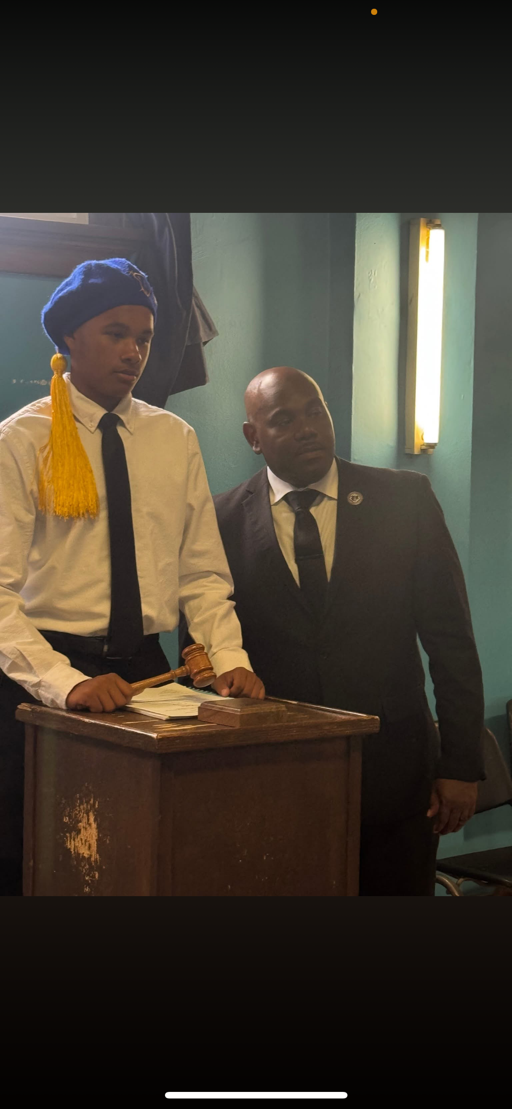

Slide 10
Leadership Development through officer roles, public speaking, and team building.
Mentorship & Brotherhood with positive male role models.
Civic Engagement via service projects and community events.
Cultural & Historical Education about Prince Hall, Masonry, and Black excellence.
Safe, Structured Environment that builds discipline, confidence, and character.
BENEFITS TO THE YOUTH

Slide 11
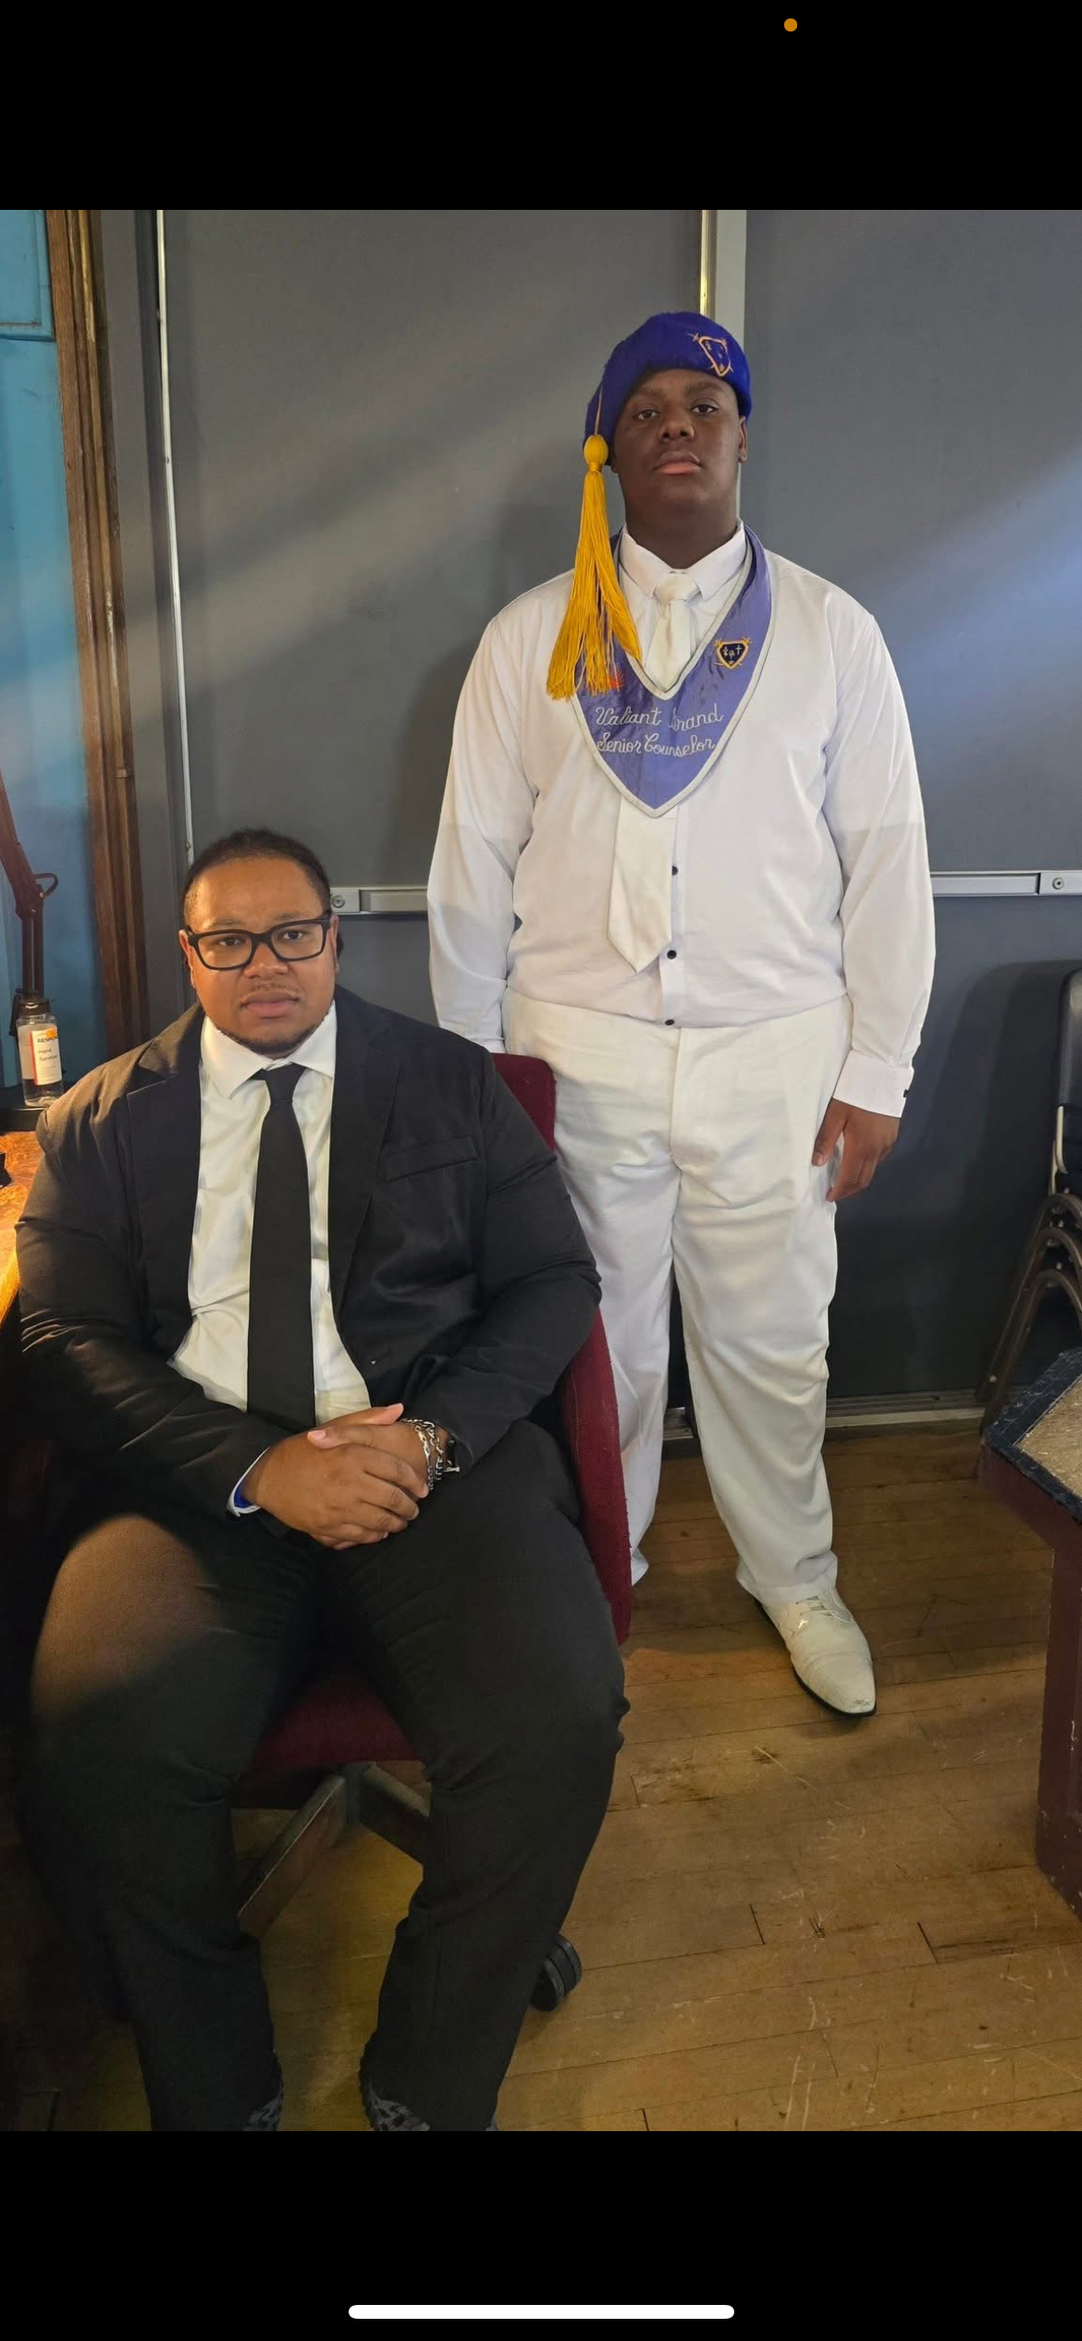

Slide 12
Statewide Interest Form & Contact List for lodges ready to participate.
District Youth Coordinator Appointments to serve as local champions.
Planning Meeting / Training Date for all interested advisors.
QR Code or Email to sign up and stay connected.
“If we don’t build the next generation, we risk losing the legacy we inherited.”
NEXT STEPS/CALL TO ACTION

Slide 13
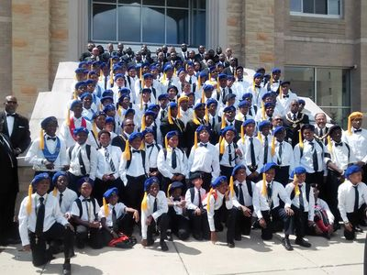

Slide 14
State and District Directors:
David B. Kenney- Jurisdiction & Central District
Antonio Bass- Evansville
Chris Campbell- Calumet
Johnny Edwards- Columbus
We are who we’re Waiting ON!

Slide 15
