Slide 1
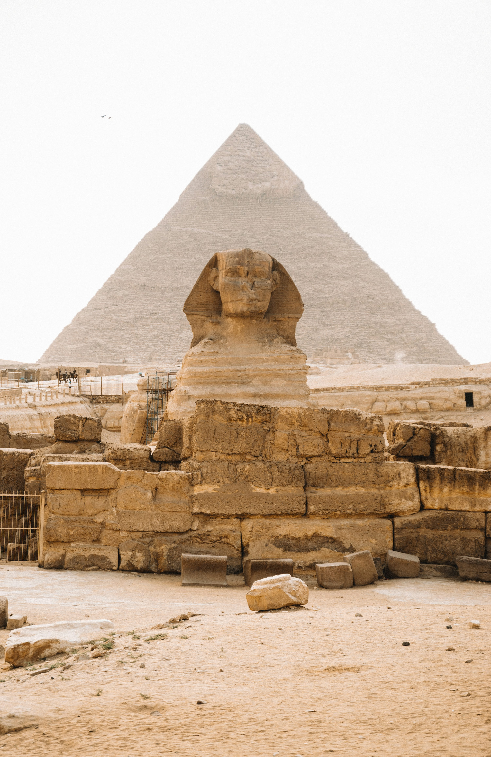
Order of Imhotep
Bro. David B. Kenney​
Central Lodge #1

Slide 2
Purpose of This Presentation
1
2
3
4
5
Present historical foundation
Show Masonic alignment
Explain youth impact
Introduce identity structure
Q&A

Slide 3
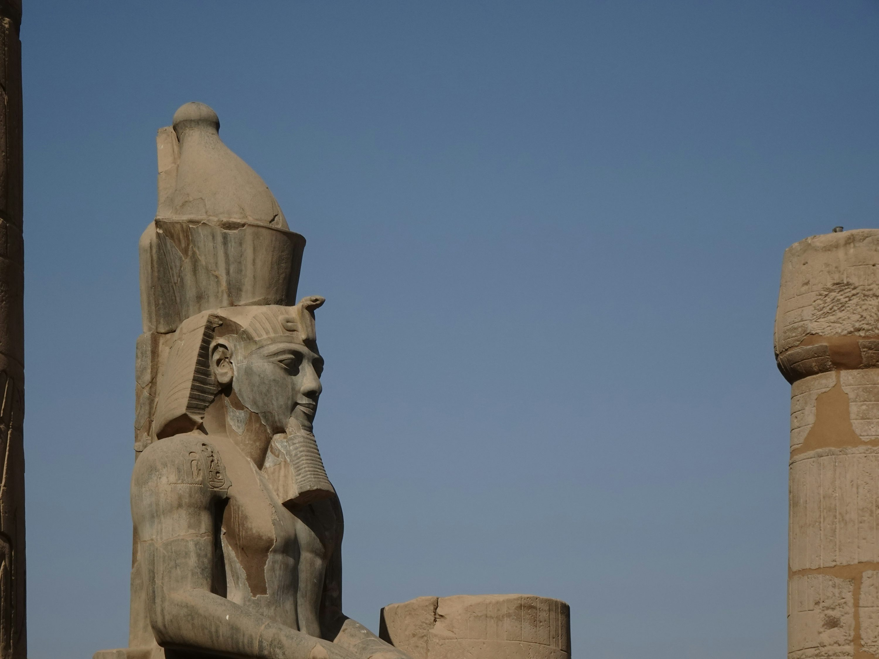
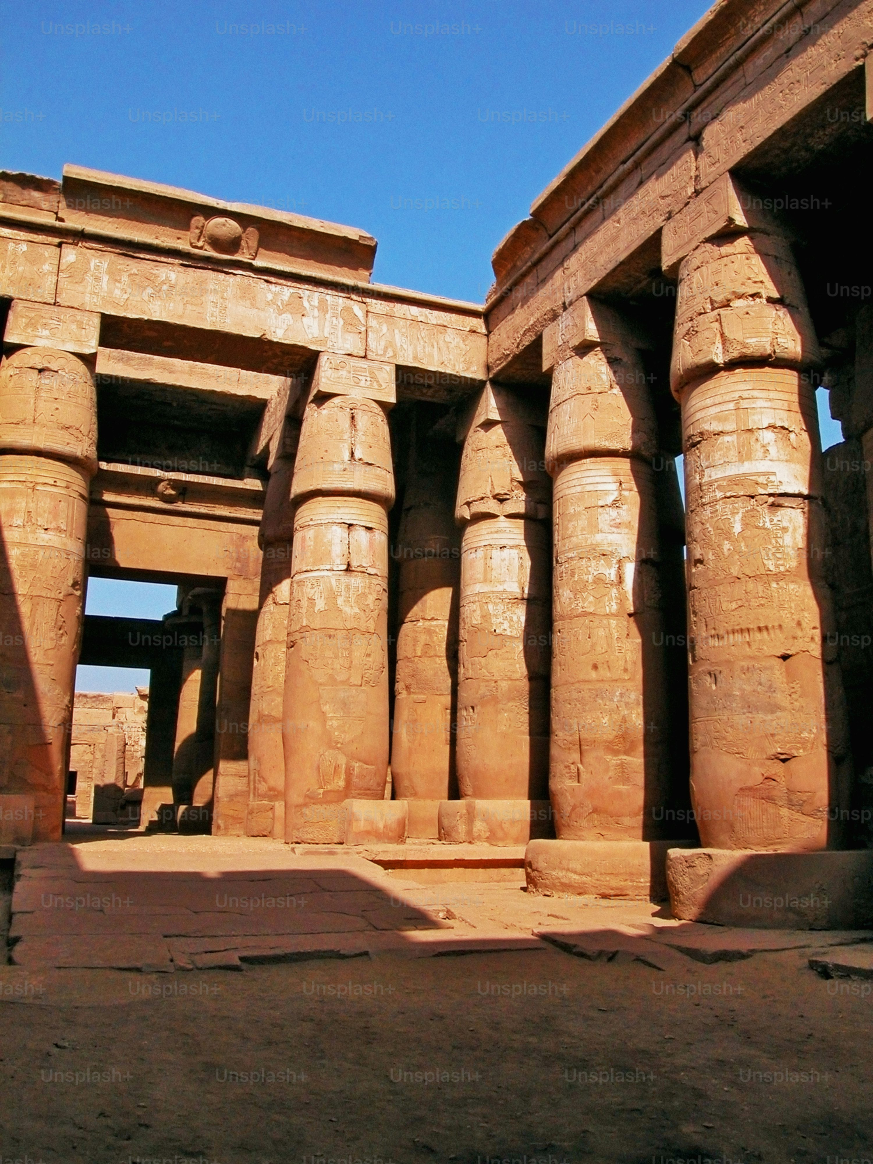
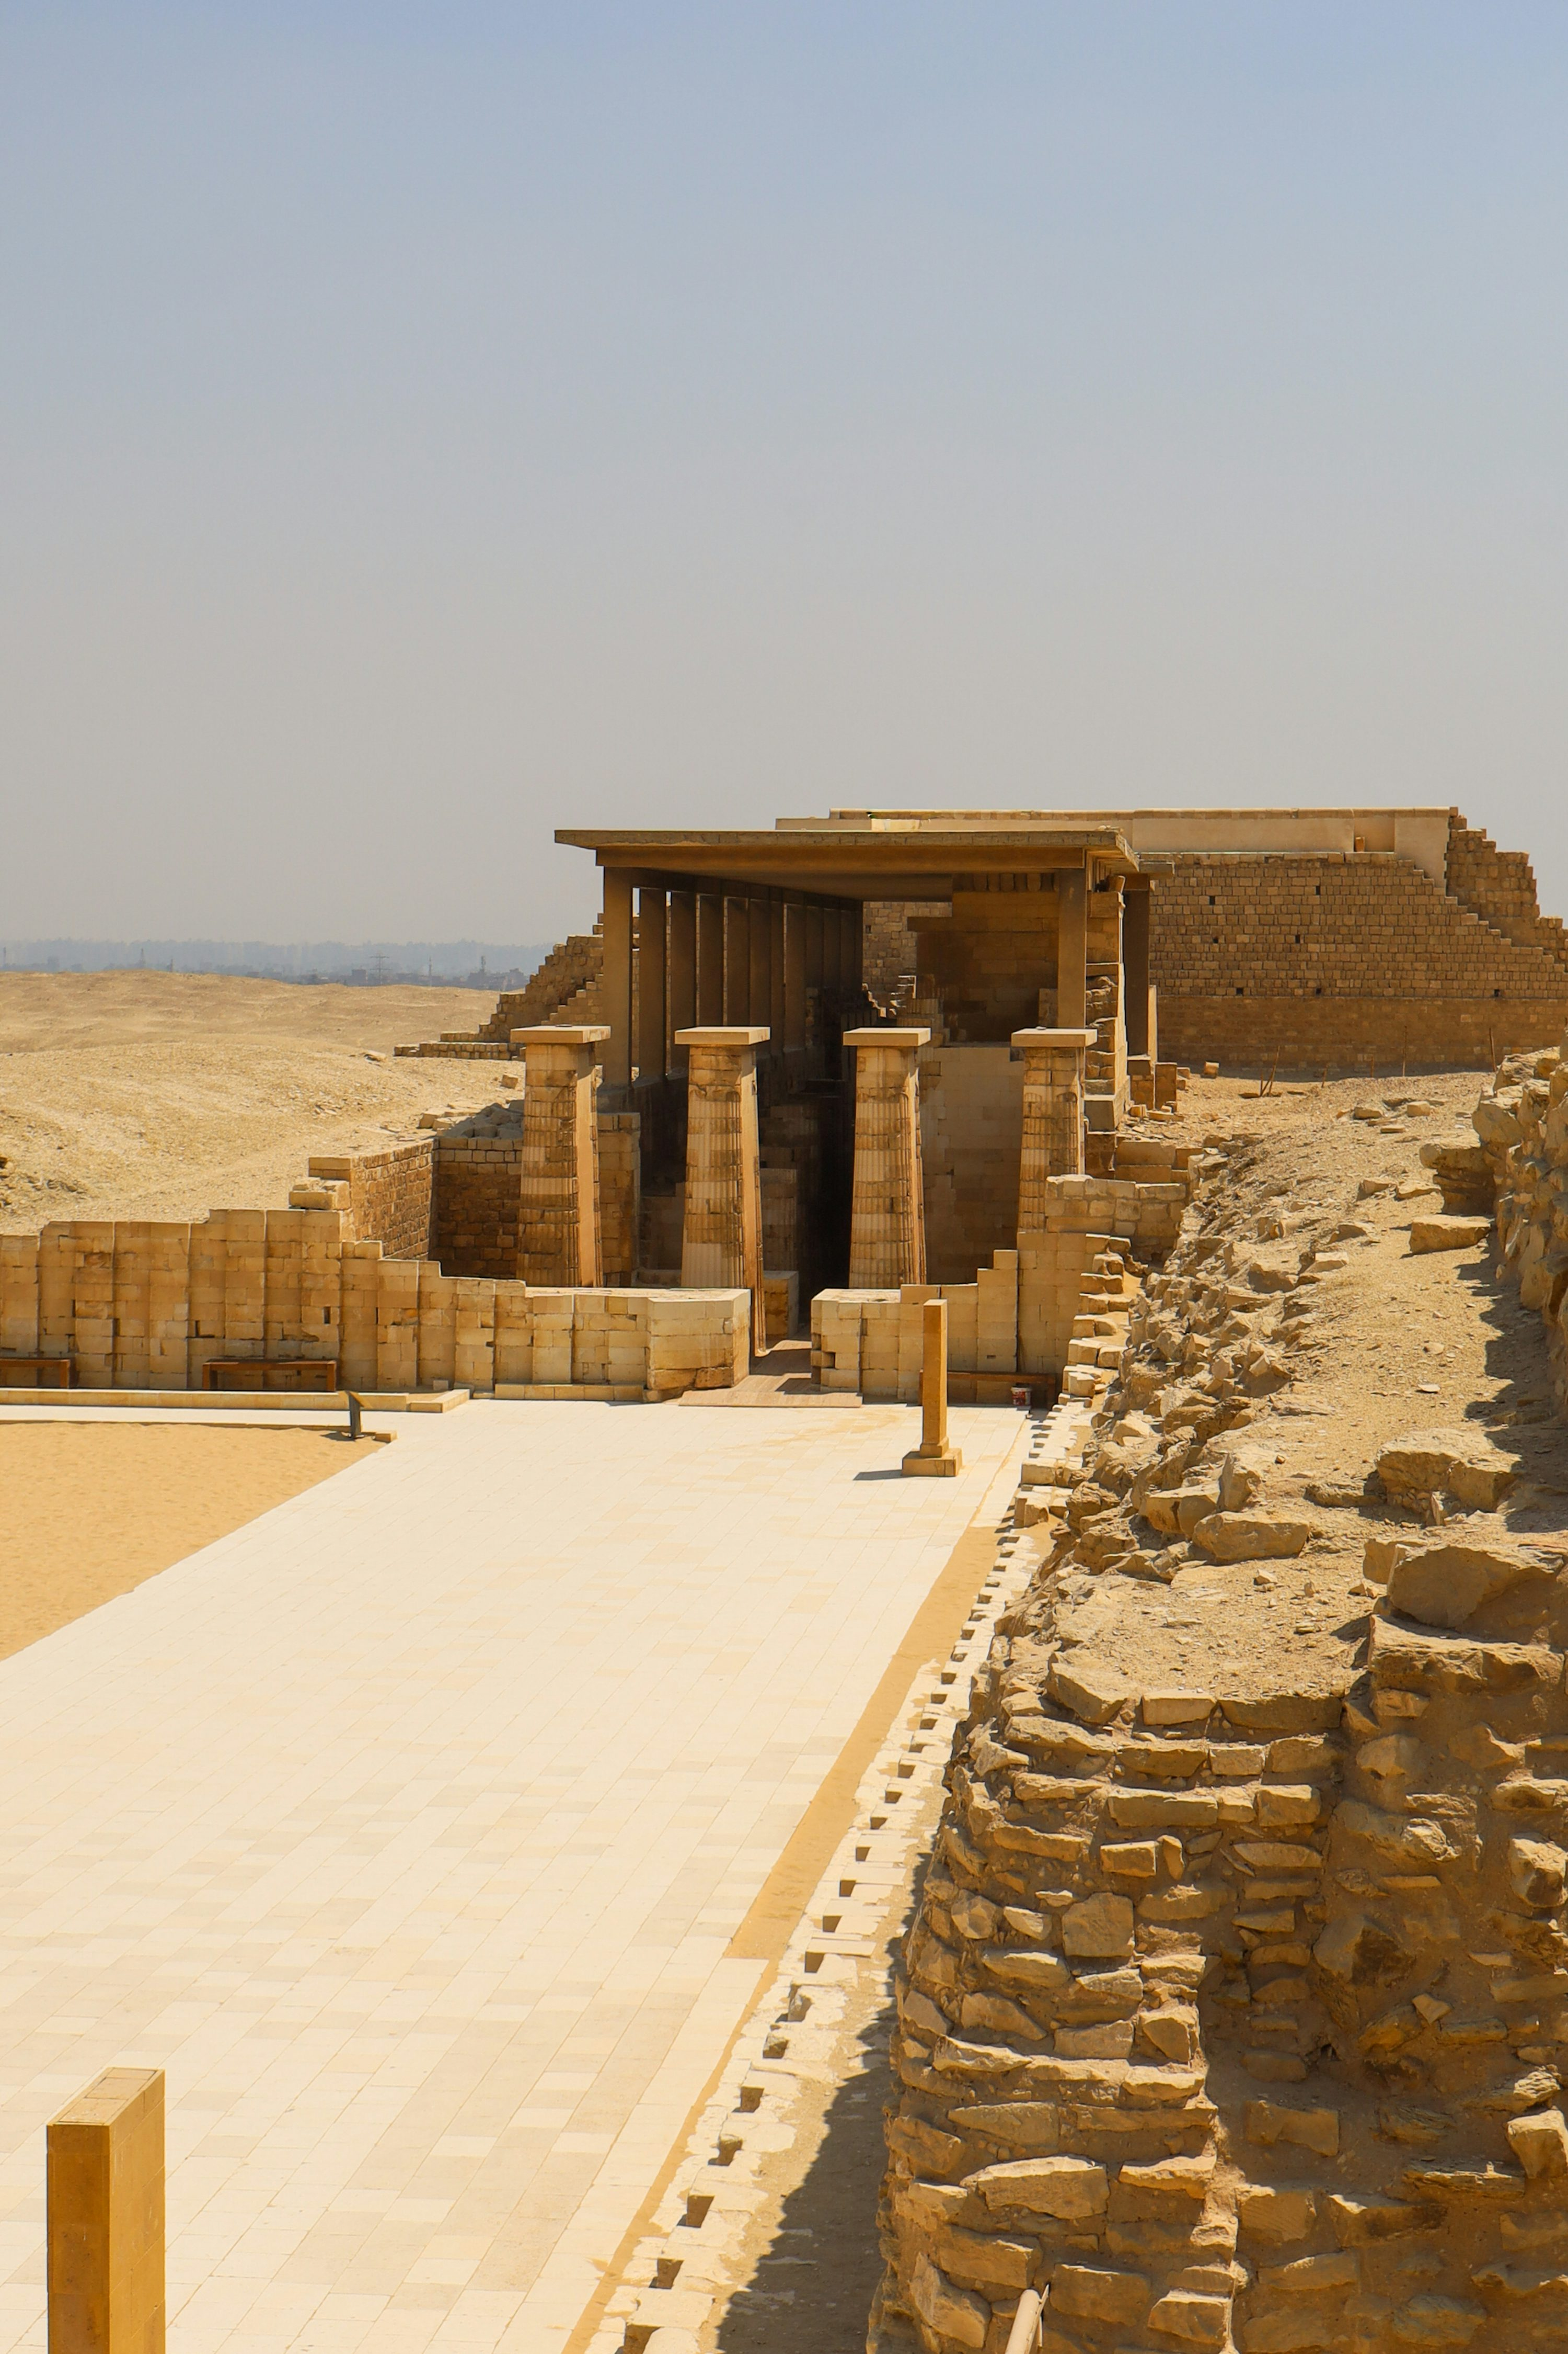
Historical Timeline of Knowledge
​2600 BCE: Imhotep (Egypt)
Egypt & Mesopotamia: Centers of learning
Greek knowledge built on earlier traditions
​
​
​

Slide 4
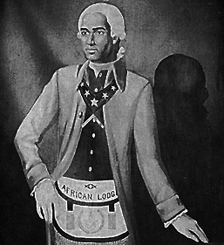
Why This Matters Now?
Strengthens historical alignment
Enhances identity for our youth
Reinforces Masonic principles
Positions the Order for future growth

Slide 5



Alignment with Freemasonry
Seek Light and truth
Honor ancient builders
Symbolism of architecture
Growth by degrees

Slide 6
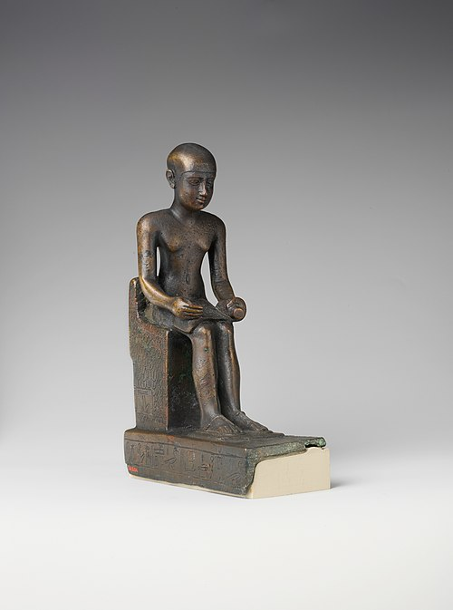
Who Was Imhotep?
1. Lived ~2600 BCE in Ancient Egypt
2. Architect of the Step Pyramid
3. Scholar, physician, priest
4. First recorded Master Builder

Slide 7
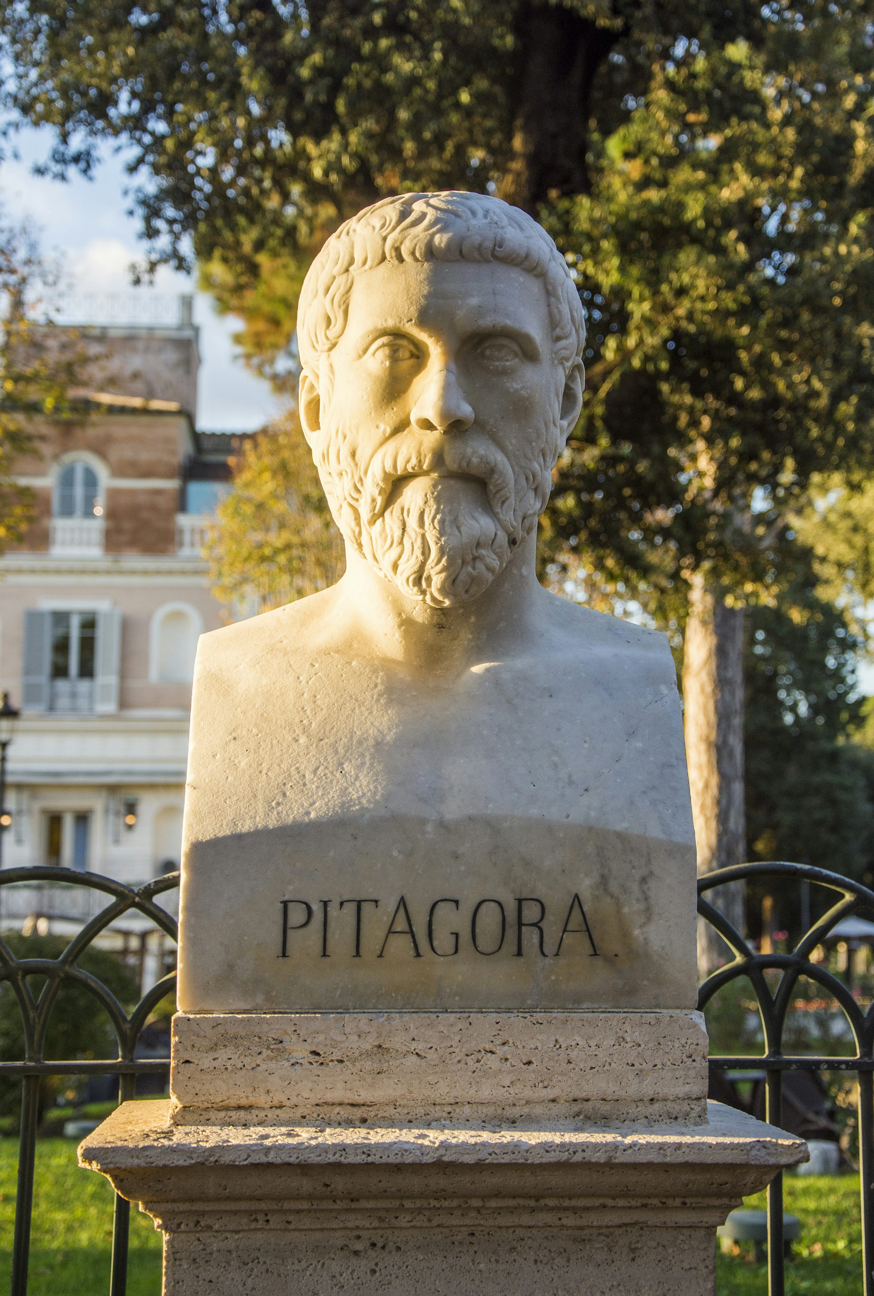
Pythagoras in Context
1. Greek philosopher (~500 BCE)
2. Studied in Egypt (classical sources)
3. Transmitter of knowledge
4. Imhotep represents the foundation

Slide 8

Background & Context
1. Ohio Advisory Workshop reflection
2. Question: Why stop at Pythagoras?
3. Research into earlier foundations
4. Guidance received to present facts

Slide 9
Imhotep represents one of the earliest recorded foundations of architecture, science, and scholarship.
Later thinkers like Pythagoras built upon knowledge preserved and studied in Egypt.
“
”

Slide 10
“This timeline illustrates that Imhotep represents one of the earliest recorded foundations of architecture, science, and scholarship. Later thinkers like Pythagoras built upon knowledge preserved and studied in places like Egypt.”
“
”

Slide 11
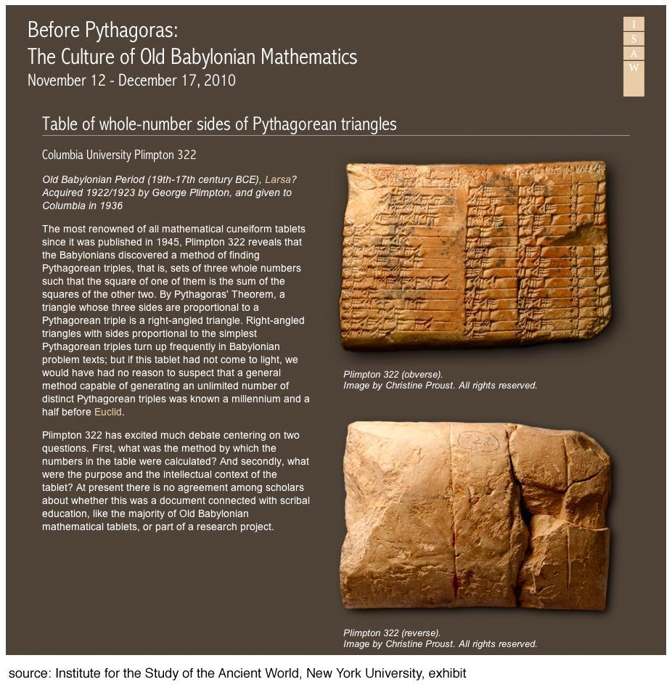
Sources & References
Herodotus
Iamblichus
Isocrates
Egyptological research

Slide 12
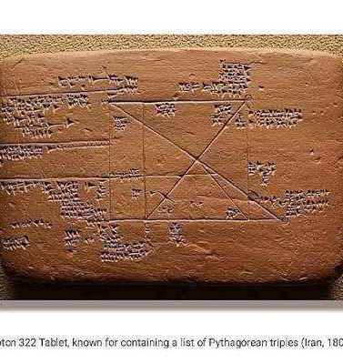
Sources & References
http://aleph0.clarku.edu/~djoyce/elements/bookI/propI47.html

Slide 13


Ceremonial Crest: detailed, educational
Shield: protection of the character
Ankh: life and moral balance
Step Pyramid: growth by degrees

Slide 14

Official Emblem: Simple and scalable

Slide 15

Impact on Our Young Men

Slide 16
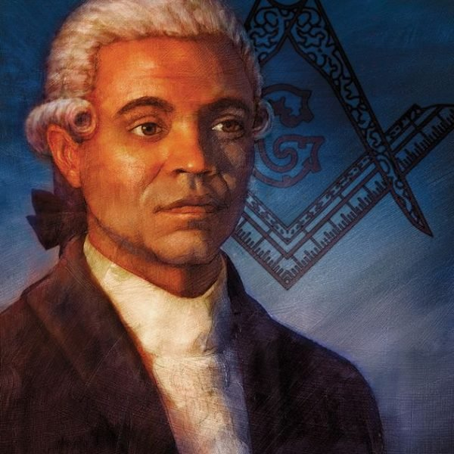
Prince Hall Perspective
1, Tradition of education and truth
2. Restoration of historical understanding
3. Honoring the full lineage of knowledge

